Slide 1


Solution to an equation
Task A: Testing solutions to equations
Fill in the table for both expressions. Use your table to find the solution to the equation.
a)
b)
c)
equation
2x + 3 = 4x − 5
 | x = 1 | x = 2 | x = 3 | x = 4 | x = 5
2x + 3 | 5 | 7 | 9 | 11 | 13
4x − 5 | −1 | 3 | 7 | 11 | 15
solution
x = 4
equation
3(x − 4) = 5x
 | x = 2 | x = 0 | x = −2 | x = −4 | x = −6
3(x − 4) | −6 | −12 | −18 | −24 | −30
5x | 10 | 0 | −10 | −20 | −30
solution
x = −6
equation
20 − 2x = 2x + 10
 | x = 1 | x = | x = 2 | x = | x = 3
20 − 2x | 18 | 17 | 16 | 15 | 14
2x + 10 | 12 | 13 | 14 | 15 | 16
solution
x =
2) Sort these equations into the correct column in the table.
has x = 2 as a solution | has x = 0 as a solution | has no solution
5x = 10
x = 3x
2x + 5 = 2x + 3
5(x + 1) = 15
x − 2 = 10x − 2
2 − x = 7 − x
3x − 6 = 0
3(2x + 5) = 6x − 2
2x − 2 = 6 − 2x

Slide 2
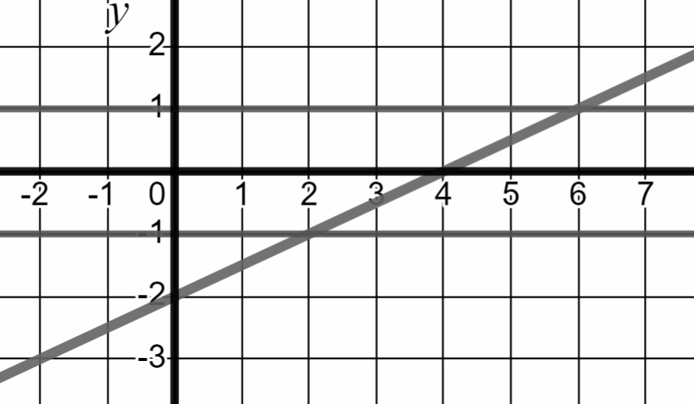
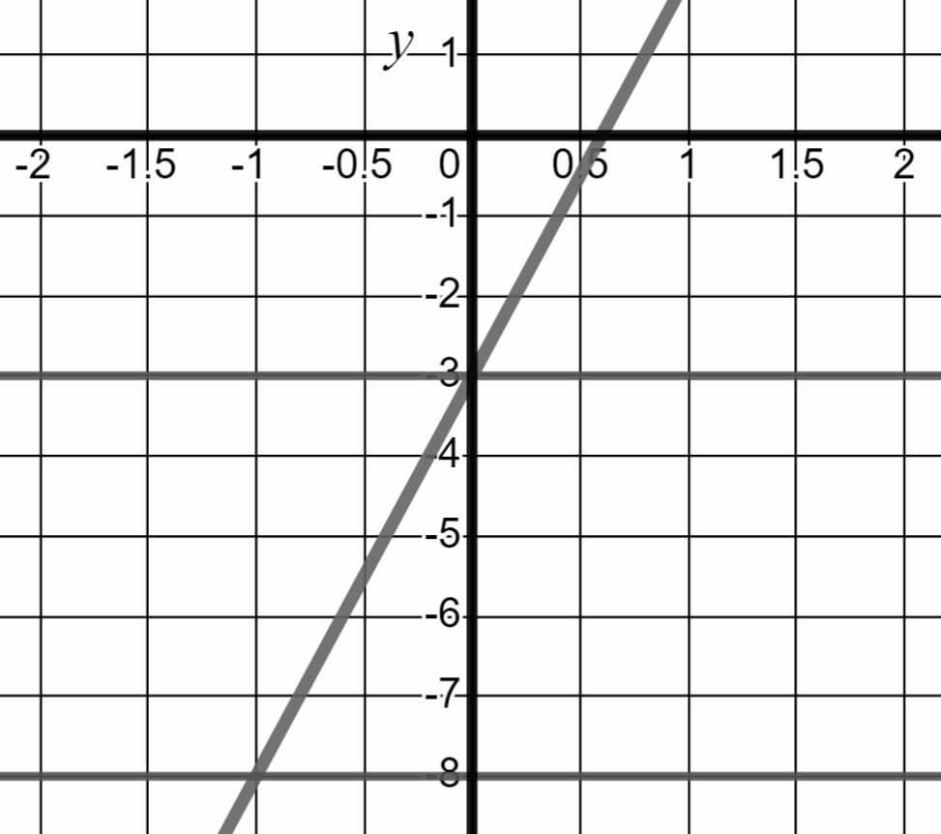
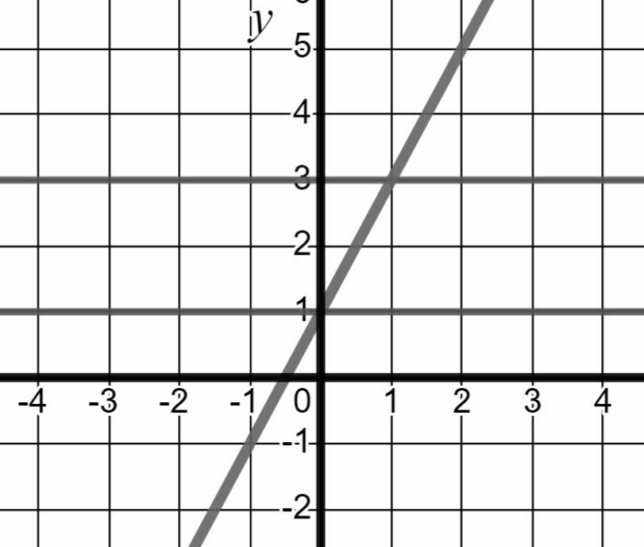

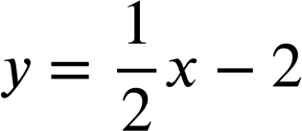


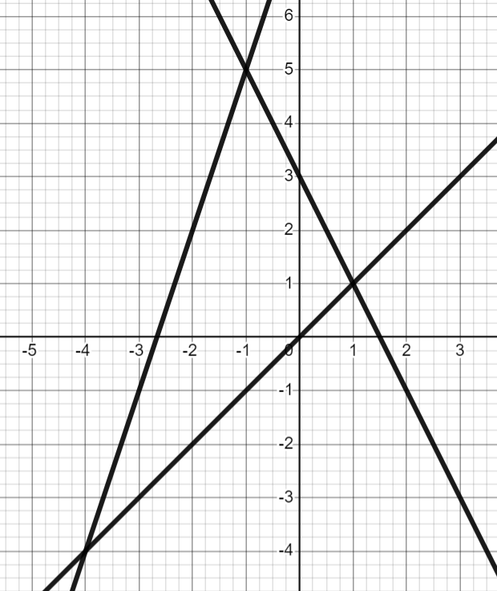
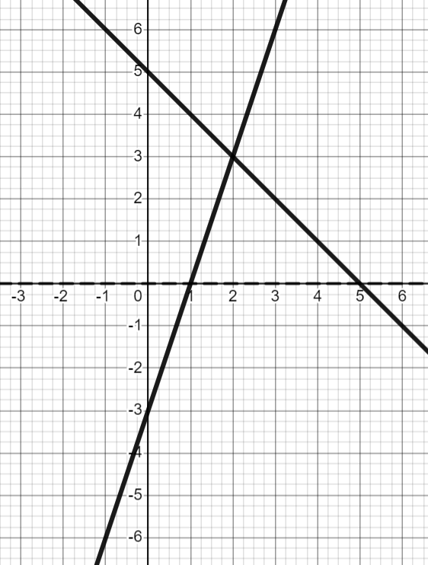



Solution to an equation
Task B: Finding solutions from graphs
1a) Use the lines on the graph to solve the equations below.
1b) Below is the graph of the equation y = 5x − 3 Use it to solve the equations.
1c) Solve the equations below by drawing the relevant graph.
equation | solution
x − 2 = 1 | x = 6
x − 2 = −1 | x = 2
equation | solution
5x − 3 = −3 | x = 0
5x − 3 = −8 | x = −1
equation | solution
2x + 1 = 3 | x = 1
2x + 1 = 1 | x = 0
2) Use the lines on the graph to solve the equations.
3) Solve the equation below by drawing the relevant graphs.
y = 3x − 3
x | −1 | 0 | 1 | 2 | 3
y | −6 | −3 | 0 | 3 | 6
y = 5 − x
x | −1 | 0 | 1 | 2 | 3
y | 6 | 5 | 4 | 3 | 2
a) | equation | solution
 | x = 3 − 2x | x = 1
b) | equation | solution
 | x = 3x + 8 | x = −4
equation | solution
3x − 3 = 5 − x | x = 2
c) | equation | solution
 | 3x + 8 = 3 − 2x | x = −1
Mathematics in Education and Industry
v2.3

